Slide 1


Online Retail Analysis
Leveraging PySpark for Large-Scale
Data Processing & Insights
Prepared By:
Al-Ghawamneh, Al-Hourani, Al-Azzam, Nwarseh, Al-Ghazaawi, Obeidat

Slide 2

Executive Summary
Project Objectives
This project leverages the power of PySpark to analyze high-volume online retail transactions. We focus on identifying customer purchasing behavior, sales performance across regions, and product popularity trends.
Analyze sales, customer, and product datasets.
Clean and preprocess raw e-commerce data. Identify geographical purchasing patterns.
Optimize data for business intelligence.
Why PySpark?
PySpark was selected for its ability to process large datasets (541,909+ rows) efficiently using distributed computing. It provides a robust framework for complex data manipulation and scalable cleaning operations.

Slide 3


Tooling & Environment Setup
Initial Environment
The project starts by initializing a Spark Session, the entry point to Spark functionality.
Libraries used include pyspark.sql for dataframe operations and
pyspark.sql.functions for advanced data cleaning.

Slide 4
Dataset Schema Overview
Key Observations
Rows: 541,909
Columns: 8 Core features
Primary Key: InvoiceNo & StockCode combined.
Global Scope: Transactions across multiple international markets.
Column Name | Data Type
InvoiceNo | String
StockCode | String
Description | String
Quantity | Integer
InvoiceDate | String
UnitPrice | Double
CustomerID | Integer
Country | String

Slide 5






Cleaning & Quality Assurance
5,268
DUPLICATE ROWS REMOVED
135k
NULL IDS HANDLED
+
Redundancy Removal
Duplicate records were filtered out using dropDuplicates() to ensure every transaction is unique and prevents skewed results.
Null Verification
CustomerID and Description columns were checked for missing values to maintain data integrity for customer profiling.

Slide 6
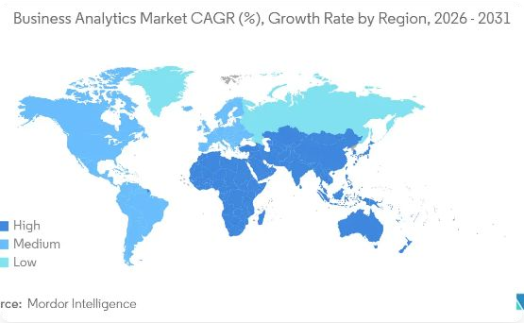

Feature Engineering
Value Generation
To understand the true impact of sales, we engineered a new column Total Price. This feature serves as the primary metric for revenue analysis.
This allows for deeper analysis of customer spending power and
geographical performance.

Slide 7





Core Analytical Operations
Filtering
Extracting high-value transactions (Qty > 10) and isolating specific markets like the United Kingdom.
Aggregation
Using groupBy() to calculate order density per country and average pricing structures per region.
Sorting
Organizing inventory based on price points to identify premium products and inventory value distribution.

Slide 8
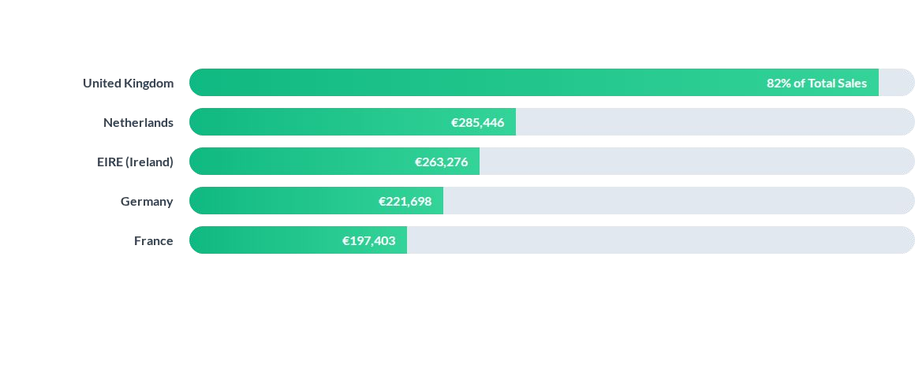
Geographical Revenue Insights
The UK remains the dominant market contributor, while Central Europe shows consistent steady growth.

Slide 9
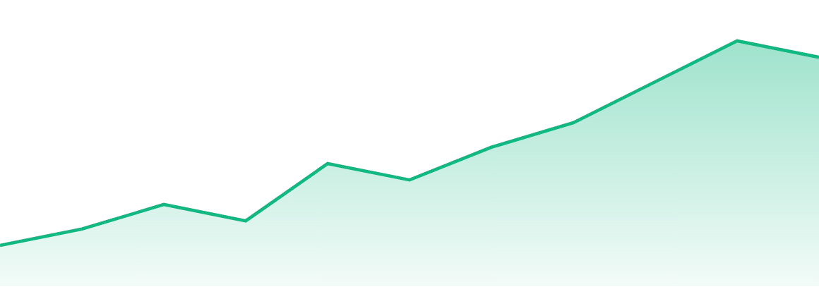
Monthly Sales Performance Trends
JanMarMayJulSepNovDec
We observe a significant Year-End Surge starting in October, attributed to seasonal purchasing patterns and holiday promotions.

Slide 10


Product & Customer Intelligence
Top 5 Products
White Hanging Heart T-Light Holder Regency Cakestand 3 Tier
Jumbo Bag Red Retrospect Party Bunting
Assorted Colour Bird Ornament
Customer Segments
Our analysis identified the "Whale" customers (High Spenders) by calculating total purchase value per CustomerID. Top spending segments are prioritized for loyalty programs.

Slide 11



Conclusion & Strategic Findings
Scalability
PySpark efficiently handled 541k+ rows, demonstrating its value for future e-commerce growth.
Cleaning Impact
Removing over 5,000 duplicates ensured that the sales trends were not inflated by technical errors.
Market Strategy
UK remains core, but high-spending clusters in EIRE and Germany represent expansion opportunities.

Slide 12

Questions?
Thank you for your attention.
Project Contributors:
Lina Al-Ghawamneh | Rawaa Al-Hourani Layali Al-Azzam | Dana Nwarseh
Batool Al-Ghazaawi | Nour Obeidat

Slide 13




Image Sources
https://png.pngtree.com/thumb_back/fh260/background/20230718/pngtree-digital-retailing-illustration-laptop-keyboard-with-shopping-basket-and-e-commerce-image_3903657.jpg
Source: pngtree.com
https://docs.kanaries.net/_next/image?url=https%3A%2F%2Fdocs-us.oss-us-west-1.aliyuncs.com%2Fimg%2Fblog-cover-images%2Fclustering-visualization.png%3Fx-oss-process%3Di mage%2Fresize%2Climit_0%2Cm_fill%2Cw_1536%2Ch_1024%2Fquality%2Cq_100&w=3840&q=75
Source: docs.kanaries.net
https://s3.mordorintelligence.com/global-business-analytics-market-industry/global-business-analytics-market-industry-Business-Analytics-Market-CAGR--Growth-Rate-by-Region-2 026---2031-1769098088713.webp
Source: www.mordorintelligence.com
https://freerangestock.com/sample/162660/focused-team-analyzing-data-on-laptop.jpg
Source: freerangestock.com

